Slide 1
ECEG-5193: Algorithm Analysis and Design
Algorithms of Graph Problems
Algorithms for fundamental graph problems

Slide 2
Graphs

Slide 3
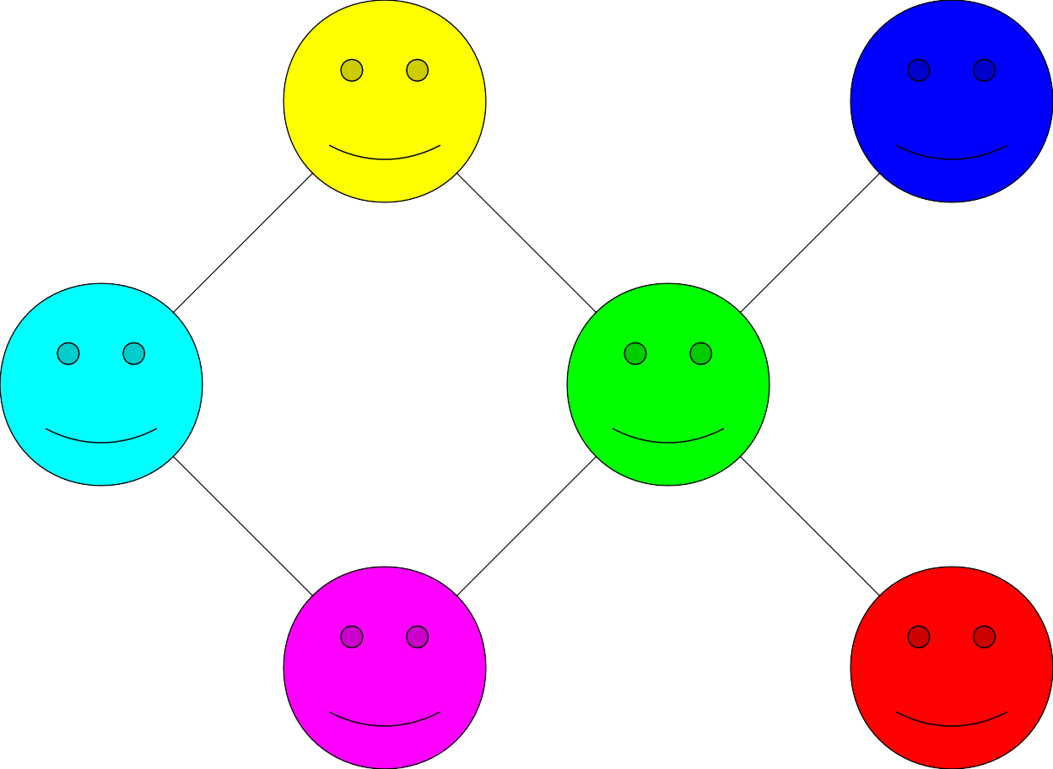
A Social Network

Slide 4
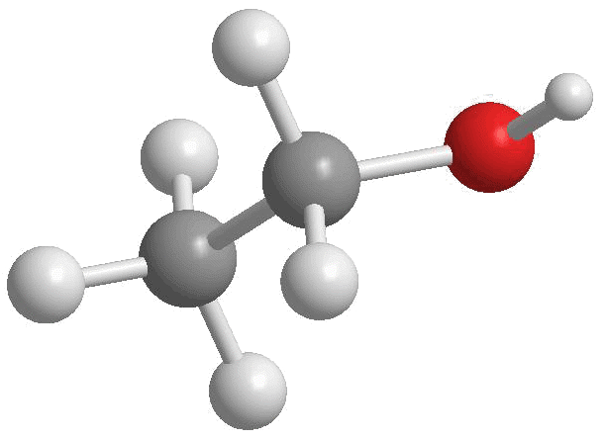
Chemical Bonds

Slide 5
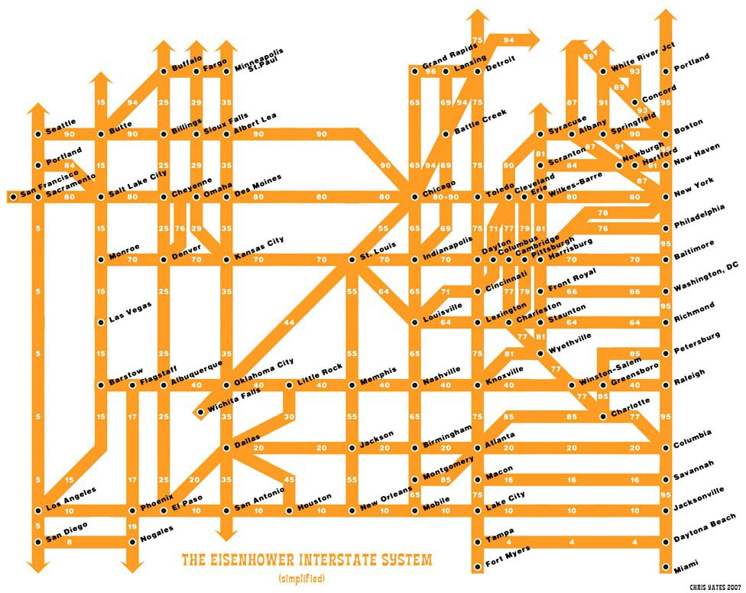

Slide 6
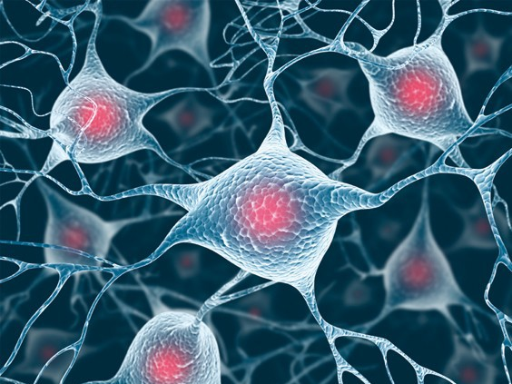
http://www.prospectmagazine.co.uk/wp-content/uploads/2009/09/163_tayl

Slide 7
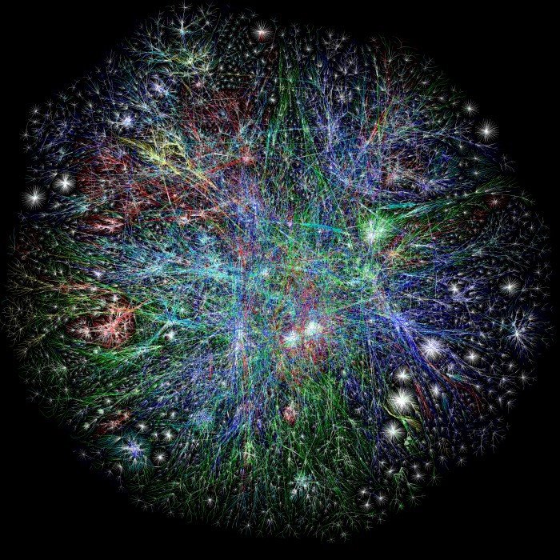

Slide 8
A graph is a mathematical structure for representing relationships.

Slide 9
A graph is a mathematical structure for representing relationships.

Slide 10
A graph is a mathematical structure for representing relationships.
A graph consists of a set of nodes
connected by edges.

Slide 11
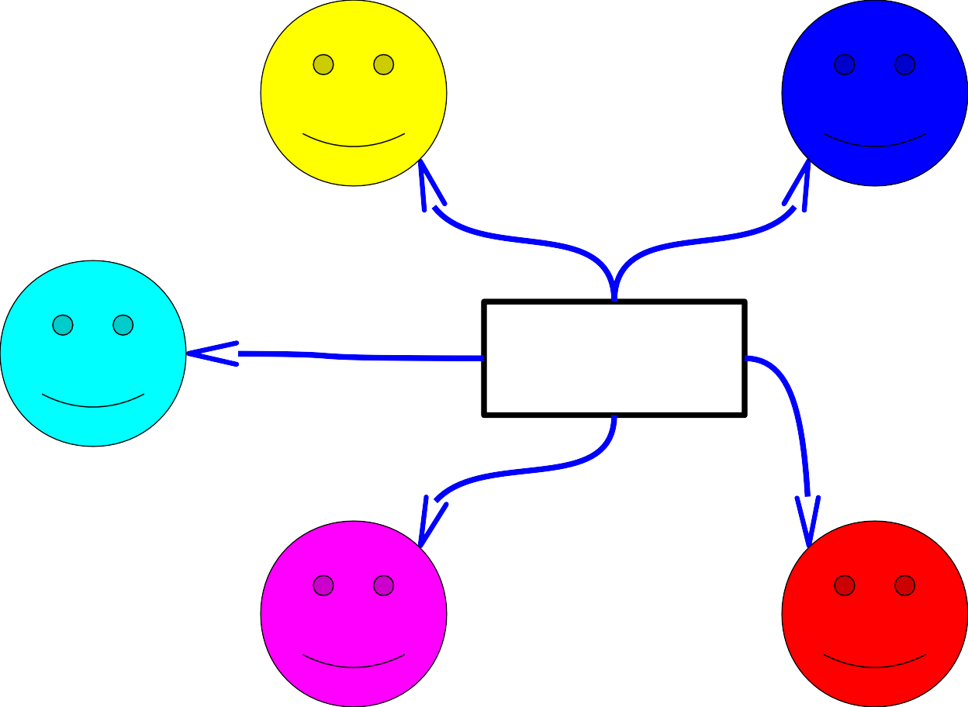
A graph is a mathematical structure for representing relationships.
Nodes
A graph consists of a set of nodes
connected by edges.

Slide 12
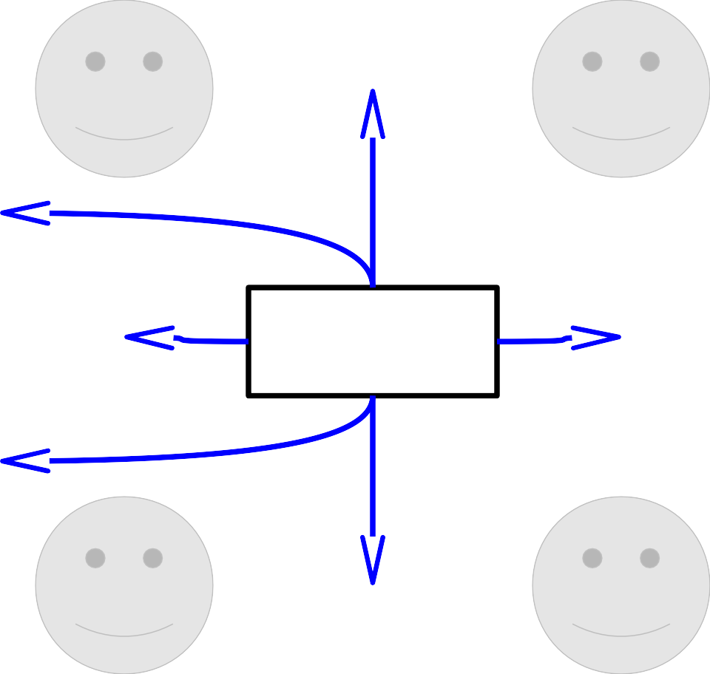
A graph is a mathematical structure for representing relationships.
Edges
A graph consists of a set of nodes
connected by edges.

Slide 13
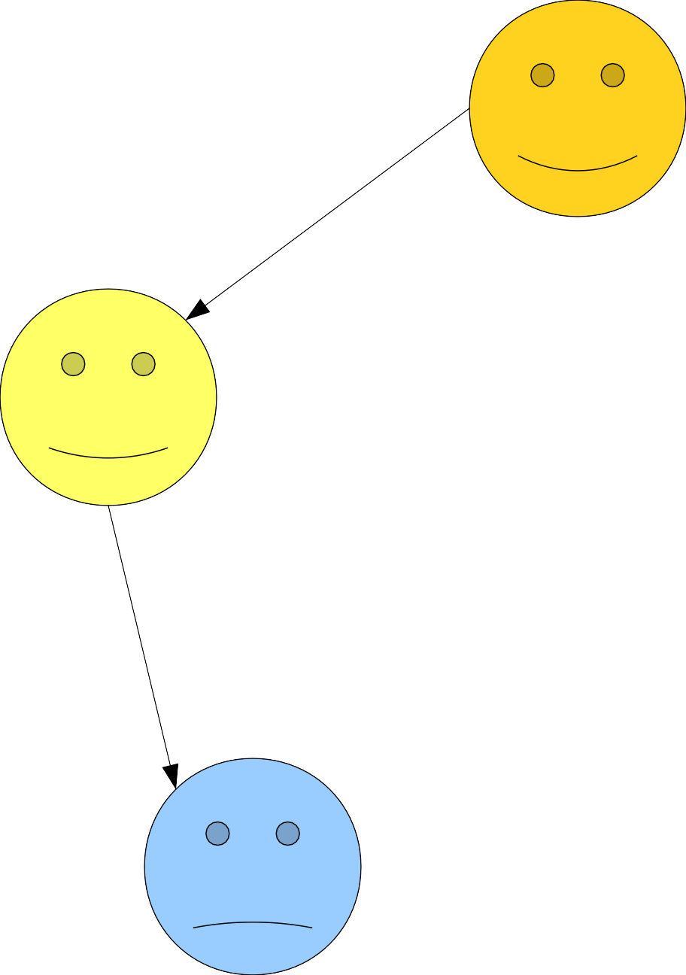
Some graphs are directed.

Slide 14
Some graphs are undirected.
CAN RAN
MAN
MAT
CAT
SAT
RAT

Slide 15
Formal Definition
A graph is an ordered pair G = (V, E) where
V is a set of the vertices (nodes) of the graph.
E is a set of the edges (arcs) of the graph.
E can be a set of ordered pairs or unordered pairs.
If E consists of ordered pairs, G is directed
If E consists of unordered pairs, G is undirected.
In an undirected graph, the degree of node v (denoted deg(v)) is the number of edges incident to v.
In a directed graph, the indegree of a node v (denoted deg ⁻(v)) is the number of edges entering v and the outdegree of a node v (denoted (deg⁺(v)) is the number of edges leaving v.

Slide 16
An Application: Six Degrees of Separation

Slide 17
A Social Network

Slide 18
A Social Network
0

Slide 19
A Social Network
1
1
1
0
1

Slide 20
A Social Network
2 2 2
1
1
2
1
0
1

Slide 21
A Social Network
3 2 2 2
3
3
1
1
2
1
0
1

Slide 22
A Social Network
3 2 2 2
4 3
1 1 4
3
4
2
1
0
1

Slide 23
A Social Network
3 2 2 2
4 3
5 1 1 4
3
5
4
5
2
1
0
1
5

Slide 24
A Social Network
3 2 2 2
4 3
5 1 1 4
3
5
4
5
2
1
0
1
5

Slide 25
A Social Network
3 2 2 2
4 3
5 1 1 4
3
5
4
5
2
1
0
1
5

Slide 26
A Social Network
3 2 2 2
4 3
5 1 1 4
3
5
4
5
2
1
0
1
5

Slide 27
A Social Network
3 2 2 2
4 3
5 1 1 4
3
5
4
5
2
1
0
1
5

Slide 28
A Social Network
3 2 2 2
4 3
5 1 1 4
3
5
4
5
2
1
0
1
5

Slide 29
A Social Network
3 2 2 2
4 3
5 1 1 4
3
5
4
5
2
1
0
1
5

Slide 30
Graphs

Slide 31
Graphs
A graph is a set of vertices V and a set of edges (u, v) ∈ E where u,v ∈ V
A
B
F
D
E
C
G

Slide 32
Different types of graphs
Undirected – edges do not have a direction
A
B
F
D
E
C
G

Slide 33
Different types of graphs
Directed – edges do have a direction
A
B
F
D
E
C
G

Slide 34
Different types of graphs
Weighted – edges have an associated weight
A
8
7
B
F
2
D
7
1
E
20
2
C
G

Slide 35
Different types of graphs
Weighted – edges have an associated weight
A
8
7
B
F
2
D
7
1
E
20
2
C
G

Slide 36
Terminology
Path – A path is a list of vertices p₁,p₂,…p_{k} where there exists an edge (p_{i},p_{i+1}) ∈ E
A
B
F
D
E
C
G

Slide 37
Terminology
Path – A path is a list of vertices p₁,p₂,…p_{k} where there exists an edge (p_{i},p_{i+1}) ∈ E
{A, B, D, E, F}
A
B
F
D
E
C
G

Slide 38
Terminology
Path – A path is a list of vertices p₁,p₂,…p_{k} where there exists an edge (p_{i},p_{i+1}) ∈ E
{C, D}
A
B
F
D
E
C
G

Slide 39
Terminology
Cycle – A path p₁,p₂,…p_{k} where p₁ = p_{k}
A
B
F
D
E
C
G

Slide 40
Terminology
Cycle – A path p₁,p₂,…p_{k} where p₁ = p_{k}
{A, B, D}
A
B
F
D
E
C
G

Slide 41
Terminology
Cycle – A path p₁,p₂,…p_{k} where p₁ = p_{k}
A
B
F
D
E
C
G

Slide 42
Terminology
Cycle – A path p₁,p₂,…p_{k} where p₁ = p_{k}
not a cycle
A
B
F
D
E
C
G

Slide 43
Terminology
Cycle – A path p₁,p₂,…p_{k} where p₁ = p_{k}
cycle
A
B
F
D
E
C
G

Slide 44
Terminology
Connected – every pair of vertices is connected by a path
connected
A
B
F
D
E
C
G

Slide 45
Terminology
Connected (undirected graphs) – every pair of vertices is connected by a path
not connected
A
B
F
D
E
C
G

Slide 46
Terminology
Strongly connected (directed graphs) – Every two vertices are reachable by a path
not strongly connected
A
B
F
D
E
C
G

Slide 47
Terminology
Strongly connected (directed graphs) – Every two vertices are reachable by a path
not strongly connected
A
B
F
D
E
G

Slide 48
Terminology
Strongly connected (directed graphs) – Every two vertices are reachable by a path
strongly connected
A
B
F
D
E
G

Slide 49
Different types of graphs
Tree – connected, undirected graph without any cycles
F
A
B
H
D
E
C
G

Slide 50
Different types of graphs
Tree – connected, undirected graph without any cycles
F
A
C
B
H
D
E
need to specify root
G

Slide 51
Different types of graphs
Tree – connected, undirected graph without any cycles
F
A
B
H
D
E
C
G

Slide 52
Different types of graphs
DAG – directed, acyclic graph
F
A
B
H
D
E
C
G

Slide 53
Different types of graphs
Complete graph – an edge exists between every node
A
F
B
D
C

Slide 54
Different types of graphs
Bipartite graph – a graph where every vertex can be partitioned into two sets X and Y such that all edges connect a vertex u ∈ X and a vertex v ∈ Y
A
E
B
C
F
D
G

Slide 55
Graphs in real life problems?
Transportation networks (flights, roads, etc.)
Communication networks
Web
Social networks
Circuit design
Bayesian networks
Notes:
A Bayesian network (also known as a Bayes network, or decision network) is a probabilistic graphical model that represents a set of variables and their
conditional dependencies via a directed acyclic graph (DAG).

Slide 56
Representing Graphs
We will typically express running times in terms of |E| and |V| (often dropping the |’s)
If |E| ≈ |V|² the graph is dense
If |E| ≈ |V| the graph is sparse
If you know you are dealing with dense or sparse graphs, different data structures may make sense

Slide 57
Representing Graphs
Assume V = {1, 2, …, n}
An adjacency matrix represents the graph as a n x n matrix A:
A[i, j] = 1 if edge (i, j) ∈ E (or weight of edge) = 0 if edge (i, j) ∉ E
An adjacency list: for each vertex v ∈ V, store a list of vertices adjacent to v

Slide 58
Representing graphs
Adjacency list – Each vertex u ∈ V contains an adjacency list of the set of vertices v such that there exists an edge (u,v) ∈ E
A:
B
D
A
B:
A
D
B
C:
D
D
E
D:
A
B
C
E
C
E:
D

Slide 59
Representing graphs
Adjacency list – Each vertex u ∈ V contains an adjacency list of the set of vertices v such that there exists an edge (u,v) ∈ E
A:
B
A
B:
B
C:
D
D
E
D:
A
B
C
E:
D

Slide 60
Graphs: Adjacency List
How much storage is required?
The degree of a vertex v = # incident edges
Directed graphs have in-degree, out-degree
For directed graphs, # of items in adjacency lists is Σ out-degree(v) = |E| takes Θ(V + E) storage (Why?)
For undirected graphs, # items in adj lists is Σ degree(v) = 2 |E| also Θ(V + E) storage
So: Adjacency lists take O(V+E) storage
Notes:
Σ degree(v) = 2 |E| (handshaking lemma)

Slide 61
Representing graphs
Adjacency matrix – A |V|x|V| matrix A such that:
A B C D E
A
A 0 1 0 1 0 B 1 0 0 1 0 C 0 0 0 1 0 D 1 1 1 0 1 E 0 0 0 1 0
B
D
E
C

Slide 62
Representing graphs
Adjacency matrix – A |V|x|V| matrix A such that:
A B C D E
A 0 1 0 1 0 B 1 0 0 1 0 C 0 0 0 1 0 D 1 1 1 0 1 E 0 0 0 1 0
A
B
D
E
C

Slide 63
Representing graphs
Adjacency matrix – A |V|x|V| matrix A such that:
A B C D E
A 0 1 0 1 0 B 1 0 0 1 0 C 0 0 0 1 0 D 1 1 1 0 1 E 0 0 0 1 0
A
B
D
E
C

Slide 64
Representing graphs
Adjacency matrix – A |V|x|V| matrix A such that:
A B C D E
A 0 1 0 1 0 B 1 0 0 1 0 C 0 0 0 1 0 D 1 1 1 0 1 E 0 0 0 1 0
A
B
D
E
C

Slide 65
Representing graphs
Adjacency matrix – A |V|x|V| matrix A such that:
A B C D E
Is it always symmetric?
A 0 1 0 1 0 B 1 0 0 1 0 C 0 0 0 1 0 D 1 1 1 0 1 E 0 0 0 1 0
A
B
D
E
C

Slide 66
Representing graphs
Adjacency matrix – A |V|x|V| matrix A such that:
A B C D E
A
A 0 1 0 0 0 B 1 0 0 0 0 C 0 0 0 1 0 D 1 1 0 0 0 E 0 0 0 1 0
B
D
E
C
Undirected graph → matrix is symmetric

Slide 67
Graphs: Adjacency Matrix
Space: How much storage does the adjacency matrix require?
A: O(V²)
Not memory efficient for large graphs.
Time: to list all vertices adjacent to u: Θ(|V|).
Time: to determine if (u, v) ∈ E: Θ(1).

Slide 68
Adjacency List vs. Adjacency Matrix
Adjacency list
Adjacency matrix
Dense graphs
Constant time lookup to discover if an edge exists
simple to implement
for non-weighted graphs, only requires boolean matrix
Sparse graphs (e.g. web)
Space efficient
Must traverse the adjacency list to discover is an edge exists
Can we get the best of both worlds?

Slide 69
Sparse adjacency matrix
Rather than using an adjacency list, use an adjacency hashtable
A:
hashtable [B,D]
A
B:
hashtable [A,D]
B
D
C:
hashtable [D]
E
D:
hashtable [A,B,C,E]
C
E:
hashtable [D]

Slide 70
Sparse adjacency matrix
Constant time lookup
Space efficient
Not good for dense graphs
A:
hashtable [B,D]
A
B:
hashtable [A,D]
B
D
C:
hashtable [D]
E
D:
hashtable [A,B,C,E]
C
E:
hashtable [D]

Slide 71
Weighted graphs
Adjacency list
store the weight as an additional field in the list
A:
B:8
D:3
A
8
3
B
D
13
2
E
10
C

Slide 72
Weighted graphs
Adjacency matrix
A B C D E
A
A 0 8 0 3 0 B 8 0 0 2 0 C 0 0 0 10 0 D 3 2 10 0 13 E 0 0 0 13 0
8
3
B
D
13
2
E
10
C

